Slide 1
MODULE 3. Content Management
What you will learn from this module:
  Proceeding to the My Profile link and updating related information
  Editing and updating web content using Toggle Design Mode
  File Management
Notes:
©2005 Microsoft Corporation. All rights reserved.
This presentation is for informational purposes only. Microsoft makes no warranties, express or implied, in this summary.

Slide 2
3. HERMES Content Management
The content management welcome page is the initial access to the Hermes CMS.
Module 3. Content Management

Slide 3
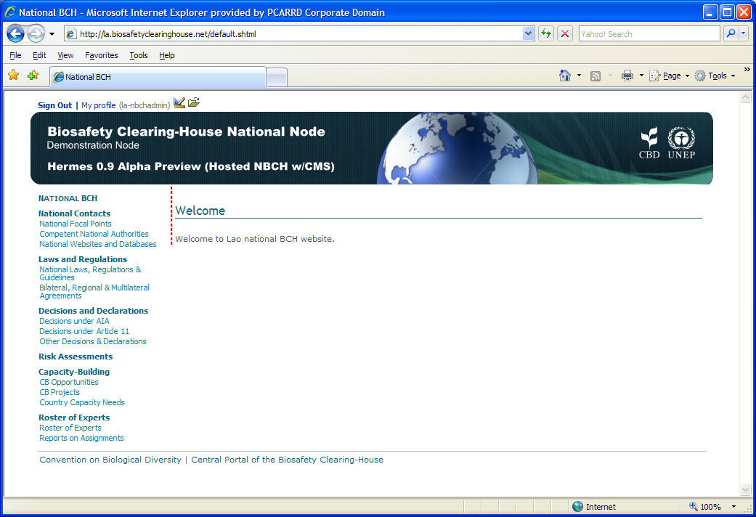
SIGN OUT/
MY PROFILE
LINKS
TOGGLE
DESIGN
MODE
FILE MANAGEMENT
HERMES Content Management Welcome Page and its components.
WEB CONTENT
AREA
LEFT
SIDE
BAR
LINKS TO
RELATED SITES
Module 3. Content Management
Notes:
©2005 Microsoft Corporation. All rights reserved.
This presentation is for informational purposes only. Microsoft makes no warranties, express or implied, in this summary.

Slide 4
HERMES Content Management
Components
Sign Out Link
The Sign out link will direct the admin user to exit the Hermes Content Management page.
My Profile Link
Administrators will be directed to its profile page.
Toggle Design Mode Icon
When clicked, administrators will be directed to design-mode of the Content Management Page.
Module 3. Content Management

Slide 5
HERMES Content Management
Components
File Mgt. Icon
When clicked, administrators can access file management
Left Side bar
Contains Quick search tool and content titles of the website.
Links to related sites
Link to other website, such as CBD and BCH Central Portal
Web content area
-see previous description-
Module 3. Content Management

Slide 6
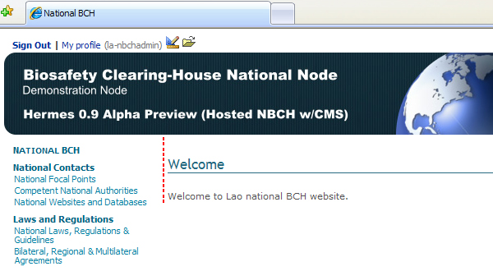
3.1 Sign Out Link
When clicked, the administrator will sign out from the content management page
Will be directed to the Welcome page of the NBCH website.
CLICK HERE
Module 3. Content Management

Slide 7
3.2 My Profile Link
When clicked, the administrator will be directed to profile page.
CLICK HERE
Module 3. Content Management

Slide 8
3.2 My Profile Link
In this page, the following information can be set for the administrator account:
  Identification – email address of the administrator (required field) and cc;
  Contact details of the administrator – such as name (required field), job title, country, phone number, etc.
Users can change the email address (or username) they use to sign-in by changing their email address in this page.
Module 3. Content Management

Slide 9
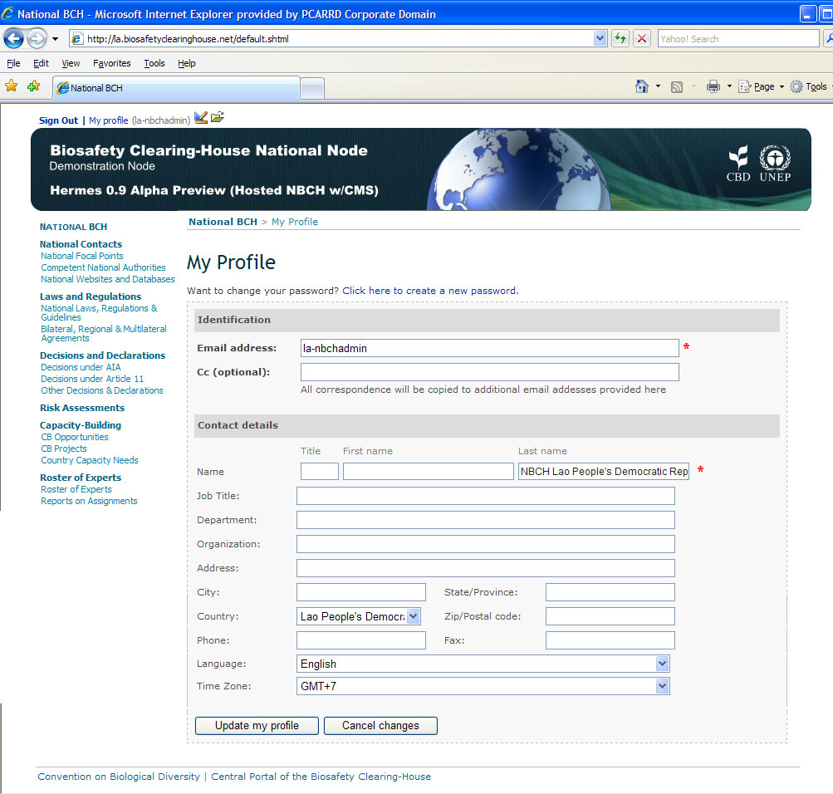
3.2 My Profile Link
REQUIRED FIELDS
Module 3. Content Management

Slide 10

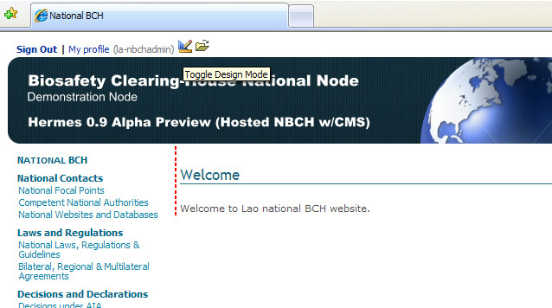

3.3 Toggle Design Mode Icon
The NBCH administrators can switch to design-mode by clicking on the icon on the top of the screen.
CLICK HERE
Module 3. Content Management

Slide 11
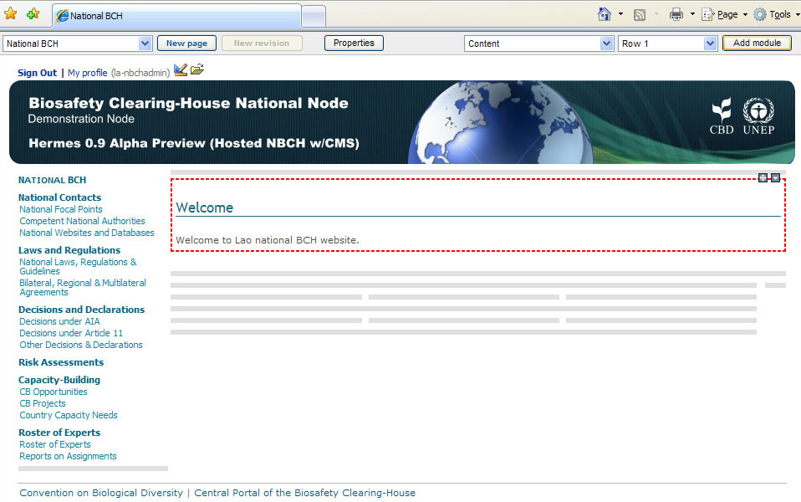
3.3 Toggle Design Mode Icon
Once in design mode, the design bar will appear on the top of the screen.
DESIGN BAR
Module 3. Content Management

Slide 12
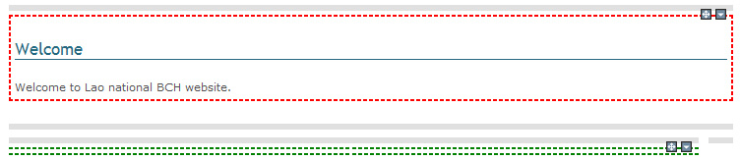
3.3 Toggle Design Mode Icon
Additionally, editable section of the site will be highlighted.
EDITABLE SECTIONS
Module 3. Content Management

Slide 13
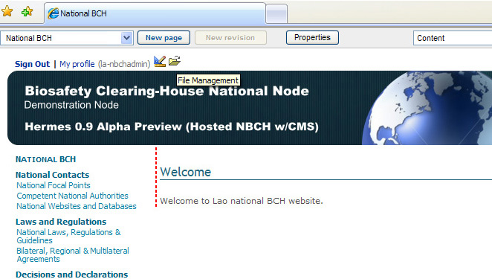
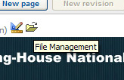
3.4 File Management Icon
The NBCH administrators can access file management by clicking on the icon on the top of the screen.
CLICK HERE
Module 3. Content Management

Slide 14
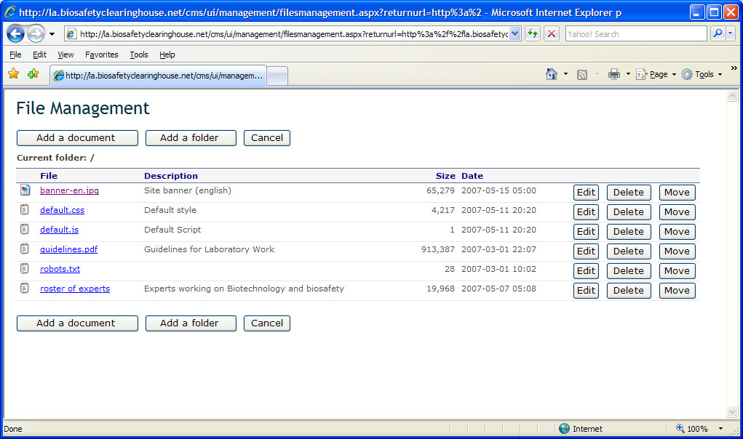
3.4 File Management Icon
Module 3. Content Management

Slide 15
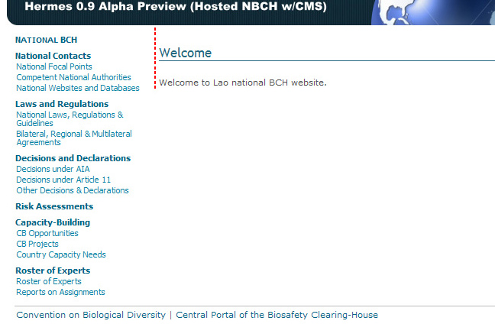
3.4.1 Left Side Bar
Includes the content titles of the web pages created for the NBCH.
LEFT SIDE BAR:
Quick SEARCH tool
and Content Titles
Module 3. Content Management

Slide 16
3.4.2 Links to Related Sites
This is true to all NBCH web pages.
Links to the following sites:
  Convention of Biological Diversity
  Central Portal of the Biosafety Clearing-House
LINKS TO
RELATED SITES
Module 3. Content Management

Slide 17
3.4.3 Web Content Area
Where editing/adding and deleting of the content is done.
User must be switched to design mode.
Editable regions will appear to all the web pages (in red or green).
Rows and columns (in gray) for all of the web pages inside the NBCH will become visible.
Module 3. Content Management

Slide 18
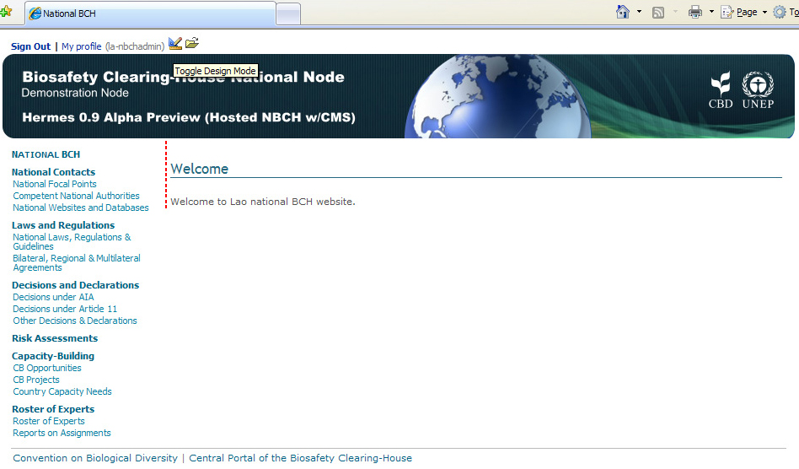
3.4.3 Web Content Area
The NBCH Welcome Page in Design Mode
NBCH WELCOME PAGE
BEFORE SWITCHING TO DESIGN MODE
NBCH WELCOME PAGE
IN DESIGN MODE
Module 3. Content Management

Slide 19
Questions?
Next: Module 4. Page Management

